Slide 1





Interest Calculations - I

Slide 2
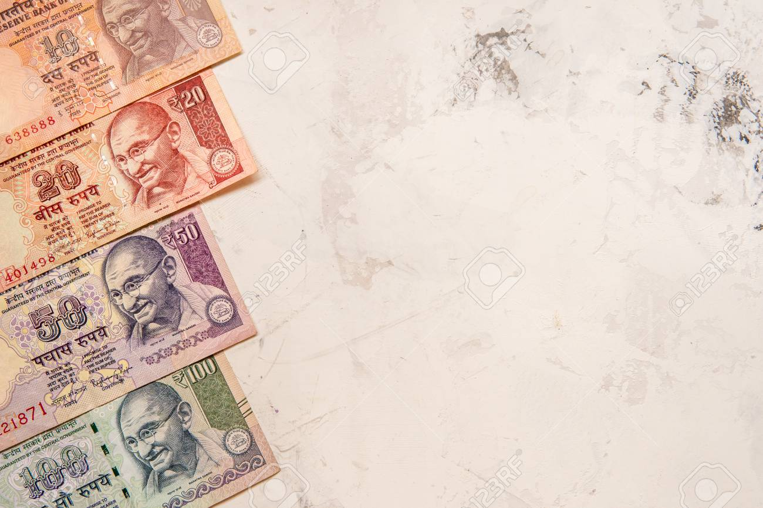




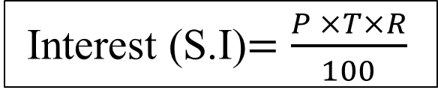

A = P + S.I
If the interest on a sum borrowed is reckoned uniformly, for a certain period, then it is called as simple interest.
Principal (P): It is the money borrowed or lent out for a certain period of time.
Interest (R): Rate of money paid regularly for using money on lent. The extra money paid by the borrower to the lender is called the interest. Interest is defined as rate (R) per cent per annum (p.c.p.a.).
Time period (T): The duration for which the money is borrowed / deposited.
It is calculated per year , if months is given divide by 12, if days is given divide by 365.
Total amount (A) : Sum of principal and simple interest.
SIMPLE INTEREST
Interest (S.I)$=\frac{P ×T×R}{100}$
Amount $=$ P + S.I
= P + $\frac{P ×T×R}{100}$
= P (1+$\frac{T×R}{100}$)

Slide 3
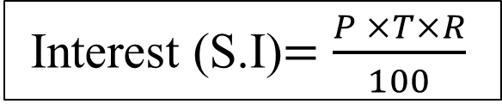

Example:
If Ramesh invests Rs.10,000 in a bank for simple interest at the rate of 10% p.a . What will be the interest after 6 years.
S.I = 6000
= $\frac{10000 ×6×10}{100}$
= 6000
(Or)
Percentage method
R = 10% T = 6 years which is equal to 60%
So 60% of 10000 = 6000
Interest (S.I)$=\frac{P ×T×R}{100}$
Principal – 10,000
10% of 10000 | 1000
10% of 10000 | 1000
10% of 10000 | 1000
10% of 10000 | 1000
10% of 10000 | 1000
10% of 10000 | 1000

Slide 4

A = P + S.I
Compound Interest is the interest calculated on the initial principal and the accumulated interest of previous periods of a deposit or loan. In easy words, it can be said as "interest on interest".
Principal (P): It is the money borrowed or lent out for a certain period of time.
Interest (R): Rate of money paid regularly for using money on lent. The extra money paid by the borrower to the lender is called the interest. Interest is defined as rate (R) per cent per annum (p.c.p.a.).
Time period (T): The duration for which the money is borrowed / deposited.
It is calculated per year , if months is given divide by 12, if days is given divide by 365.
Total amount (A) : Sum of principal and simple interest.
COMPOUND INTEREST
Compound Interest is the interest calculated on the initial principal and the accumulated interest of previous periods of a deposit or loan. In easy words, it can be said as "interest on interest".
Amount $=P\left(1+\frac{R}{100} \right)n$
Compound Interest (C.I)$=A −P$
= $P\left(1+\frac{R}{100} \right)n$ - P
= P[($\left(1+\frac{R}{100} \right)n$) – 1]

Slide 5
A = P + S.I
If 25,000 is deposited under simple interest and compound interest at 10% p.a for 4 years. What will be difference between their interest?
Compound Interest is the interest calculated on the initial principal and the accumulated interest of previous periods of a deposit or loan. In easy words, it can be said as "interest on interest".
SIMPLE INTEREST Rs.25000
COMPOUND INTEREST Rs.25000
Year | Interest | Interest
I | 10% of 25000 = 2500 | 10% of 25000 = 2500
II | 10% of 25000 = 2500 | 10% of 25000 + 10% of 2500 = 2500+250 = 2750
III | 10% of 25000 = 2500 | 10% of 25000 + 10% of 2500 +10% of 2500+ 10% of 250 = 2500+250+250+25 = 3025
IV | 10% of 25000 = 2500 | 10% of 25000 + 10% of 2500 + 10% of 2500 + 10% of 2500 + 10% of 250+ 10% of 250 + 10% of 250+ 10% of 25 = 2500+250+250+250+25+25+25+2.5 = 3327.5
 |  | 2500+2750+3025+3327.5 = 11602.5
Total | 40% of 25000 = Rs.10000 | Rs.11602.50 (approx 46.41%)

Slide 6


A = P + S.I
Some important formulae:
Compound Interest is the interest calculated on the initial principal and the accumulated interest of previous periods of a deposit or loan. In easy words, it can be said as "interest on interest".
If a sum of money becomes x-times of itself in T-years @ R% p.a. S.I. then (x -1)100 = T×R
If a sum of money becomes “X₁“ -times of itself in a time of “ T₁“ years @ “R₁“% p.a. S.I and It becomes “X₂“ times of itself in “ T₂“ years @ “ R₂“ % p.a. S.I. then
$\frac{\text{X}\text{1}−1 }{\text{X}\text{2}\text{ − 1}}$ = $\frac{T1×R1}{T2×R2}$
A sum (P) of money becomes an amount of “A₁“ in “ T₁“ years at a certain rate and the same sum becomes an amount of “A₂“ in “ T₂“ years (“ T₂“ > “ T₁“) . Then
P = $\frac{\text{A}\text{1}\text{T}\text{2} \text{ − }\text{A}\text{2}\text{T}\text{1}}{\text{T}\text{2} −\text{T}\text{1}}$ and the rate R = $\frac{\text{(}\text{A}\text{1 }\text{ − }\text{P}\text{)}}{\text{P}\text{T}\text{1}}$ $×$ 100

Slide 7


A = P + S.I
If the rates of compound interest are R₁, R₂, R₃........... R_{n} for n-successive years then,
Amount (A) $=P\left(1+\frac{\text{R}\text{1}}{100} \right)\left(1+\frac{\text{R}\text{2}}{100} \right)\left(1+\frac{\text{R}\text{3}}{100} \right) ×$…………. $\left(1+\frac{\text{R}n}{100} \right)$.
If a sum of Rs P is lent out at R% p.a. compound interest for n-years then
Amount $=P\left(1+\frac{R}{200} \right)2n$ , if the interest is compounded half yearly.
Amount $=P\left(1+\frac{R}{400} \right)4n$ , if the interest is compounded Quarterly.
The difference between compound interest and simple interest on a sum of Rs P for 2-years at R% p.a. is given by
Difference(D) $=P\left(\frac{R}{100} \right)2$
Compound Interest is the interest calculated on the initial principal and the accumulated interest of previous periods of a deposit or loan. In easy words, it can be said as "interest on interest".

Slide 8
Problems based on Doubling, Tripling , etc (SIMPLE INTEREST):
Example:
A sum of money invested at simple interest triples itself in 8 years at simple interest. Find in how many years will it become 9 times itself at the same rate?
Logical Explanation:
Let the amount invested be ‘P’.
Amount = P + S.I
Years | Interest (S.I) | Amount (P+S.I)
8 | 2P | 3P
16 | 4P | 5P
24 | 6P | 7P
32 | 8P | 9P
40 | 10P | 11P
48 | 12P | 13P
Amount = P + S.I
Given Amount becomes triples in 8 years. so
A = 3P
3P = P + S.I
S.I = 2P
So,
Since it becomes 2P in 8 years it will become 4P in 16 years , 6P in 24 years , 8P in 32 years.
If S.I = 8P then the amount will be 9P in 32 years.

Slide 9

Problems based on Doubling, Tripling , etc (COMPOUND INTEREST):
Example:
A sum of money invested at Compound interest triples itself in 8 years . Find how many times will it become at the end of 32 years at the same rate?
Problems based on Doubling, Tripling (COMPOUND INTEREST):
Example:
A sum of money invested at compound interest triples itself in 8 years. Find how many times will it become at the end of 32 years at the same rate?
Let the amount invested be ‘P’.
Amount $=P\left(1+\frac{R}{100} \right)n$
3P = P $\left(1+\frac{R}{100} \right)$⁸
(3P)⁴ = $P\left(1+\frac{R}{100} \right)$^{4*8}
Therefore it becomes 81 times in 32 years.
Years | Amount
8 years | 3 times P
16 years | 9 times P
24 years | 27 times P
32 Years | 81 times P

Slide 10



